Slide 1
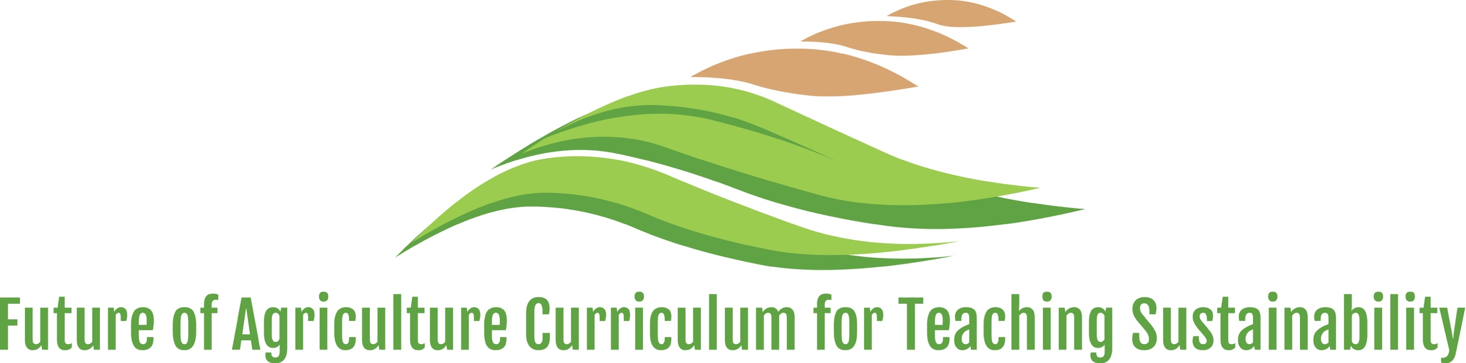
Cell Biology
By C. Kohn
Michigan State University

Slide 2
Living Organisms are Carbon Based
All living organisms are carbon-based.
  Carbon atoms make up the largest percentage of the dry weight of living organisms.
All living organisms have cells.
  A cell is the smallest thing that can be alive.
  A cell is the basic building-block of living organisms.
All cells have a membrane.
  A membrane is barrier that forms the outside of a cell.
  A membrane protects the inside of the cell, allowing it to maintain a constant internal environment.
  If the membrane is broken (or lysed), a cell cannot survive.

Slide 3
Group Questions
What is the smallest thing that can be alive?
What is necessary for this to be alive and why?

Slide 4
Atoms, Molecules, and Cells
Some organisms are single-celled.
  Bacteria are examples of living organisms that consist of only one cell.
Some organisms have many cells.
  Plants and animals typically consist of trillions of cells.
Similar cells will connect to each other to form tissue.
  Different tissues that serve a
  single function create organs.
  Organs make up the systems
  that make up the entire
  organism.
For example, your body has a
circulatory system.
  The circulatory system is
  comprised of a heart, blood
  vessels, and other organs.
  Each of these organs is comprised
  of different tissues, and each tissue
  is comprised of many similar cells.
Bacteria are single-
celled organisms
Plants and animals are comprised of systems, which are made of organs, which contain tissues, which are made of cells.
Source: reellifescience.com

Slide 5
Group Questions
Explain how each of the following relate to each other: Atoms, Cells, Tissues, Systems, and Bodies.

Slide 6
Cells are made from molecules
A chain of
amino acid
molecules
An amino acid
molecule
Cells are made of a large amount of many different kinds of molecules.
  Molecules are made of combinations of bonded atoms.
One of the most important molecules in a cell are its proteins.
  Proteins are large molecules that perform most of the functions of the cell.
  Proteins are like molecular machines, and there are thousands of different kinds of proteins in most cells.
Proteins are macromolecules, or very large molecules that are made out of smaller molecules.
  All proteins are made by stringing together specialized molecules called amino acids.
  The order of amino acids determines the shape of the protein. This shape determines its function.
  The visible traits of living organisms are the direct
  result of the shape and function of its proteins.
Source: commons.wikimedia.org
Source: Socratic
A protein pump
made from
several chains
of amino acids.
Source: faculty.southwest.tn.edu

Slide 7
Group Questions
A protein is a macromolecule. What does this mean?
  Begin by explaining how proteins are assembled from amino acids.
  Explain how we know that an amino acid is a molecule and not an atom.
  Then explain how proteins are formed and how this results in a protein being a macromolecule.
Why are proteins important? How do they affect the function of cells and of organisms?

Slide 8
Cells can have organelles
Mitochondria
Nucleus
Source: how-to-draw-cartoons-online.com
Most organisms have cells that have organelles.
  Organelles are specialized structures inside cells. They contain
  specific proteins that enable it to perform particular functions.
  Examples of organelles include the nucleus and mitochondria.
Plant and animal cells have an important organelle called the mitochondria.
  The mitochondria in plant and animal cells can convert the energy in the bonds of glucose sugar molecules into forms of energy that the cell can directly use.
  The process of breaking down glucose in the mitochondria is cellular respiration.
When a cell absorbs oxygen and glucose sugar molecules during cellular respiration, the mitochondria rearranges these molecules to produce CO2 and H2O.
  This frees up energy stored in glucose that the
  cell can then use for its own needs.
The cell stores this energy in another molecule
called ATP.
  ATP works like a molecular
  rechargeable battery for the cell.
Cellular
Membrane
Source: commons.wikimedia.org
Glucose &
Oxygen In
Mitochondria
Uncharged ATP In
Charged ATP Out
CO2 &
H2O Out

Slide 9
Group Questions
Chloroplasts and mitochondria are organelles.
  What are organelles?
  What is the purpose of an organelle?

Slide 10
Cellular Respiration
Uncharged
ATP
Cellular respiration occurs in the mitochondria.
  The mitochondria absorbs a glucose molecule and six oxygen molecules.
  The atoms of these molecules are rearranged to form six carbon dioxide and six water molecules.
The CO2 and H2O molecules give off large amounts of energy when they are formed.
  This energy is stored in ATP.
The primary purpose of respiration is to charge ATP molecules.
  The chemical energy stored in the bonds of ATP can directly power the cell’s activities.
Charged
ATP
Glucose
Oxygen
Source: commons.wikimedia.org
Water
Carbon
Dioxide

Slide 11
Group Questions
Summarize how cellular respiration occurs in the mitochondria.
  What goes into the mitochondria and what comes out during cellular respiration?
  What is the overall purpose of cellular respiration?

Slide 12
Chloroplasts
CO2 &
H2O
Light Energy
Plant cells are unique in that they have an additional organelle called the chloroplast.
  The chloroplast is the organelle that can rearrange CO2 and H2O molecules into
  glucose sugar and O2 molecules during photosynthesis.
  The chloroplast is able to absorb light energy and convert it into the chemical bond energy of a glucose molecule.
A plant cell’s chloroplasts produce glucose sugar for its own needs.
  A plant cell can send glucose directly to its mitochondria to be used for cellular energy (converting glucose and oxygen back
  into CO2 and H2O).
Source: Google Sites
Chloroplast
Glucose & O2
Chemical Energy
Chloroplast
CO2 & H2O
Source: commons.wikimedia.org
Glucose & O2
Mitochondria

Slide 13
Group Questions
Summarize how photosynthesis occurs in the chloroplast.
  What goes into the chloroplast and what comes out during photosynthesis?
  What is the overall purpose of photosynthesis?
How are the substances that go into and out of the mitochondria during cellular respiration similar to what goes into and out of the chloroplast during photosynthesis?

Slide 14
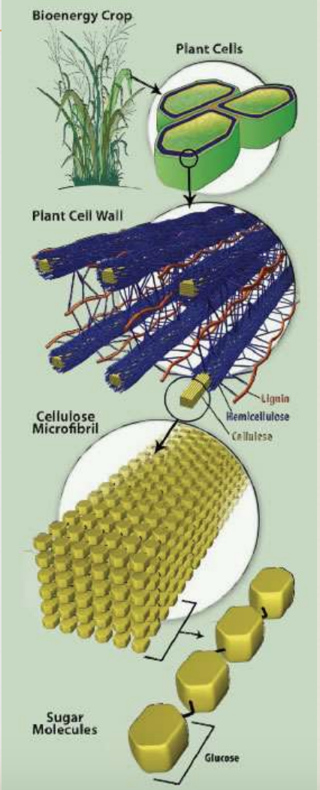
Cellulose
Full Plant
Plant Cell
Plant cells can also use glucose molecules to make other plant molecules needed for plant tissue in a process called biosynthesis.
  Biosynthesis is the process in which living organisms produce new molecules by rearranging the atoms of other molecules.
For example, plant cells have tough cell walls made out of cellulose.
  Cellulose gives plants their rigid structure (similar to how a skeleton gives structure to an animal’s body).
  Cellulose is made from long chains of individual glucose molecules.
Plant
Cell Wall
Cellulose
Chains of
Glucose
Molecules
Source: GLBRC.org
Glucose

Slide 15
Cellulose
Full Plant
Plant Cell
Cellulose is a carbohydrate, or a macromolecule made of long chains of individual glucose molecules.
  Fibers, starches, and sugars are all examples of carbohydrates.
Plants are unique in that they can use the carbon in inorganic carbon dioxide molecules to make organic carbon-based molecules like glucose and cellulose.
  Inorganic molecules are those that are not a part of something that is alive (like CO2).
  Organic molecules are those that are a part of a carbon-based living organism (like glucose).
Plant
Cell Wall
Cellulose
Chains of
Glucose
Molecules
Source: GLBRC.org
Glucose

Slide 16
Biomass
Plants are able to produce biomass using CO2.
  Biomass is short for biological mass, or the
  amount of organic living tissue that exists in
  an organism or in a given area.
Photosynthesis increases the amount of biomass.
  Photosynthesis converts inorganic CO2 and H2O
  molecules into glucose and oxygen molecules.
  A plant can use glucose to produce plant tissue.
  Other organisms can consume plants to produce
  their own tissue (such as when an cow eats grass).
Cellular respiration, decomposition, and combustion decrease the amount of biomass.
  During cellular respiration, carbon-based organic
  molecules are broken down into CO2 and H2O.
  Similarly, when living tissue decomposes (rots) or is burned (combusted), it is also converted into CO2 and H2O.
During photosynthesis, CO2 & H2O are converted into biomass.
Source: (SEOS) Project
Chloroplast
Source: Google Sites
More
Biomass
CO2 & H2O
Glucose & O2
Less
Biomass
Source: commons.wikimedia.org
Mitochondria

Slide 17

CO₂
Respiration, decomposition, and burning decrease the amount of biomass and increase the amount of CO2.
Source: oogazone.com
Photosynthesis increases the amount of biomass and decreases the amount of CO2.
Biomass

Slide 18
Group Questions
Where does the carbon-based mass in a plant come from?
  Include the following in your answer: biosynthesis; photosynthesis; sugar molecules; cellulose; carbohydrates.
True or false: all of the carbon atoms in your body began as carbon atoms in a glucose molecule.
  Explain
What is biomass? Where does it come from?
What process(es) increase the amount of biomass?
What process(es) decrease the amount of biomass?

Slide 19
Movement of Carbon in Biomass
When plants produce biomass during photosynthesis, they are moving carbon atoms out of CO2 in the air and into organic carbon-based molecules in the plant.
  These molecules include glucose as well as other forms of plant molecules such as cellulose.
When these carbon-based molecules are consumed, (either by the plant itself or an animal), much of the carbon in those molecules is respired as CO2 and returned to the atmosphere.
  Only a portion of the carbon atoms become a part of the organism that is consuming it.
INPUTS
OUTPUTS

Slide 20
The 10% Rule
90% of the energy in the animal’s food is converted to heat and lost. 10% of the energy remains in the animal as the energy of the chemical bonds in its biomass.
When biomass is consumed by an organism, most of the energy and a large
portion of the carbon atoms escape from the organism.
  For example, about 90% of the
  carbon atoms that were in the
  diet of this beef animal will be lost
  as CO2 or in their manure.
  About 90% of the energy in the
  feed of this animal will be lost as
  heat.
  Only 10% of the carbon atoms
  and energy consumed become
  a part of the animal’s biomass.
Because of this, it would take about
10 times as much plant biomass to
support this animal’s biomass.
  If a carnivore (such as a person) eats
  the meat from this animal, they will
  also only acquire about 10% of the
  carbon atoms and energy in the meat.
Energy
Carbon Atoms
INPUTS
OUTPUTS

Slide 21
Group Questions
What is the 10% rule?
How does it help to explain why there are so many more plants than animals in an ecosystem?
How does the 10% rule explain why there are so many more herbivores than carnivores in ecosystems?

Slide 22
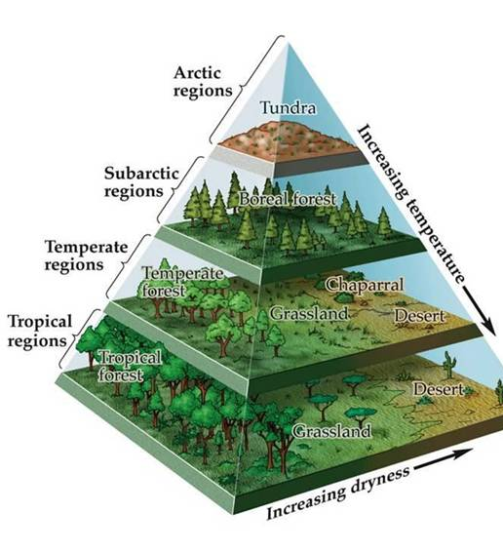
Species Productivity
The amount of living species that an area can support is determined by the rate at which plants can produce biomass from CO2 and H2O.
  Sunnier, warmer, wetter climates enable more biomass production.
  Darker, drier, colder climates have less biomass production.
For example, the warm, wet Amazon rainforest tends
to have a large amount and a wide variety of living species.
  The Amazon climate allows for a large number of
  plants to produce huge amounts of biomass.
  This abundance of biomass can support a wide
  variety of other living species in addition to plants.
The cold, dry Antarctic continent is unable to
support large amounts of plant life.
  Because it is cold and dry, much less CO2 & H2O
  is converted into biomass.
  This results in far less biodiversity in polar areas.
Small amounts of biomass
Large amounts of biomass
Source: http://www.hippoch.com/uploads/1/5/9/8/15988944/844906_orig.jpg

Slide 23
Group Questions
Why do areas that are sunnier, warmer, and wetter usually have a wider variety of species and a greater number of living organisms than areas that are colder, drier, and cloudier?
  Explain using the 10% rule.

